Slide 1
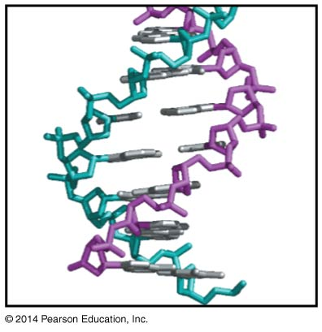
DNA Structure + RNA structure
BT 451
Chapter 4 and Chapter 5

Slide 2
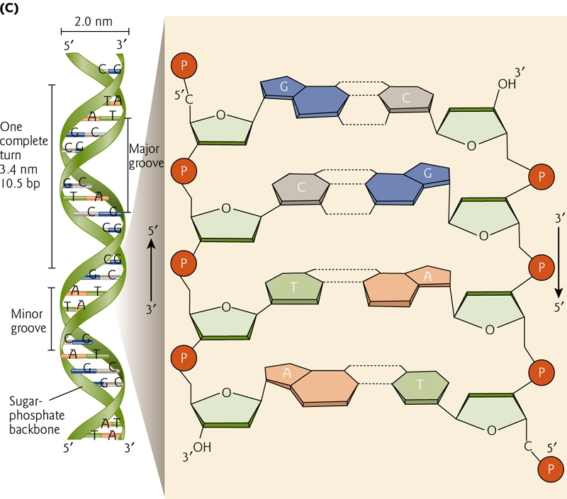
DNA a double helix
Back bone
Sugar
Phosphate
Bases
Purine
Pyramidine
Major & minor grooves

Slide 3
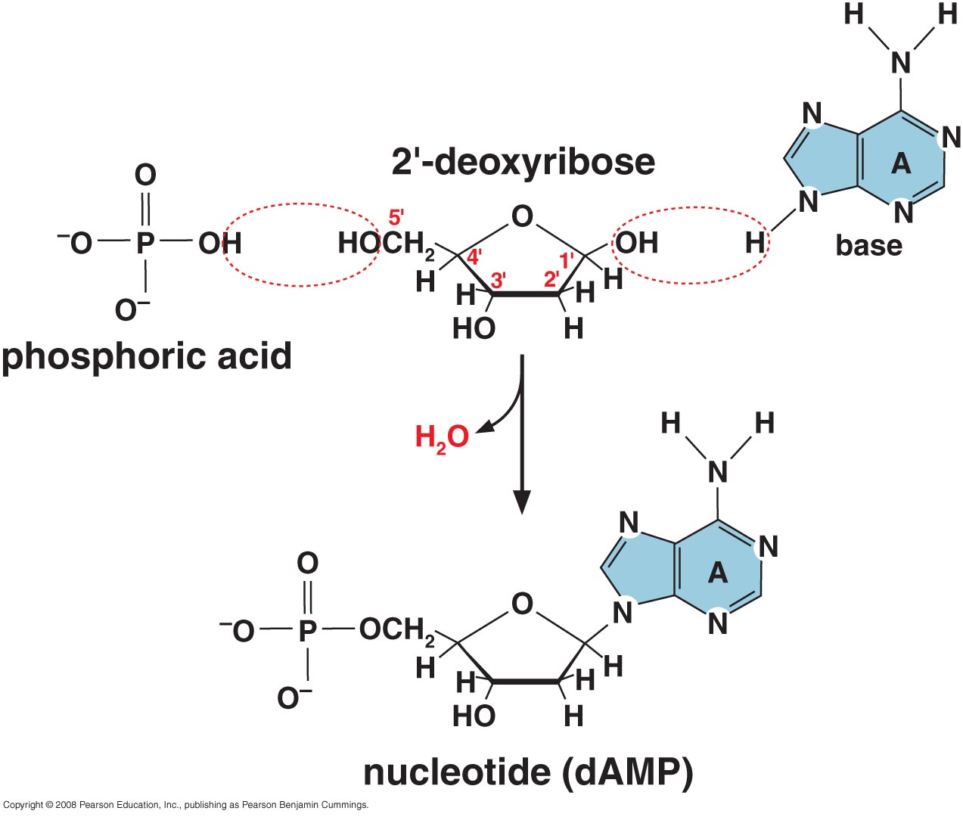
Building the Nucleotide

Slide 4
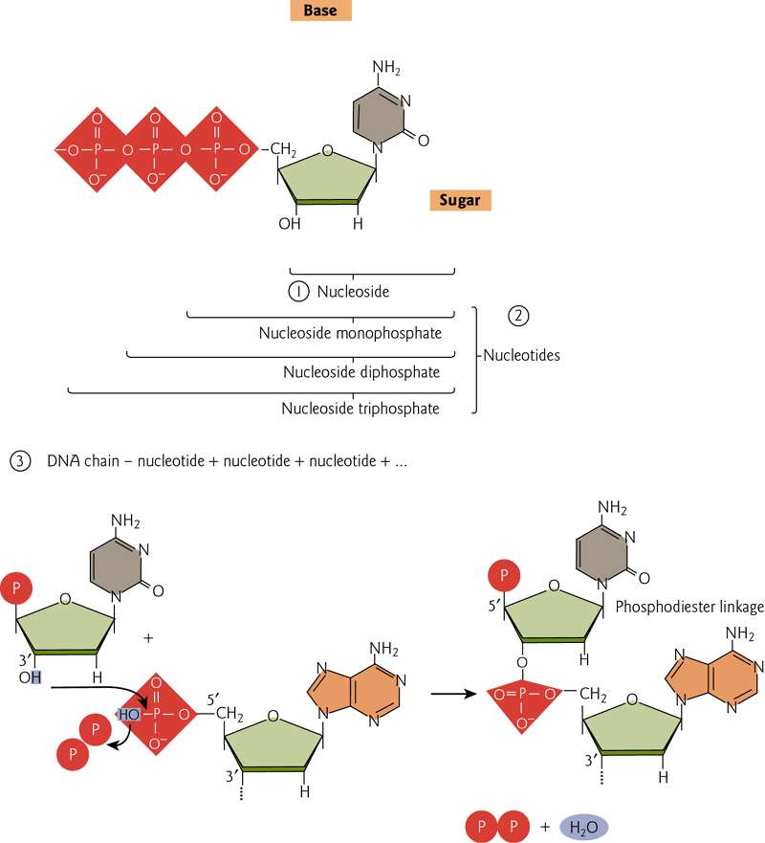
Building blocks of DNA

Slide 5
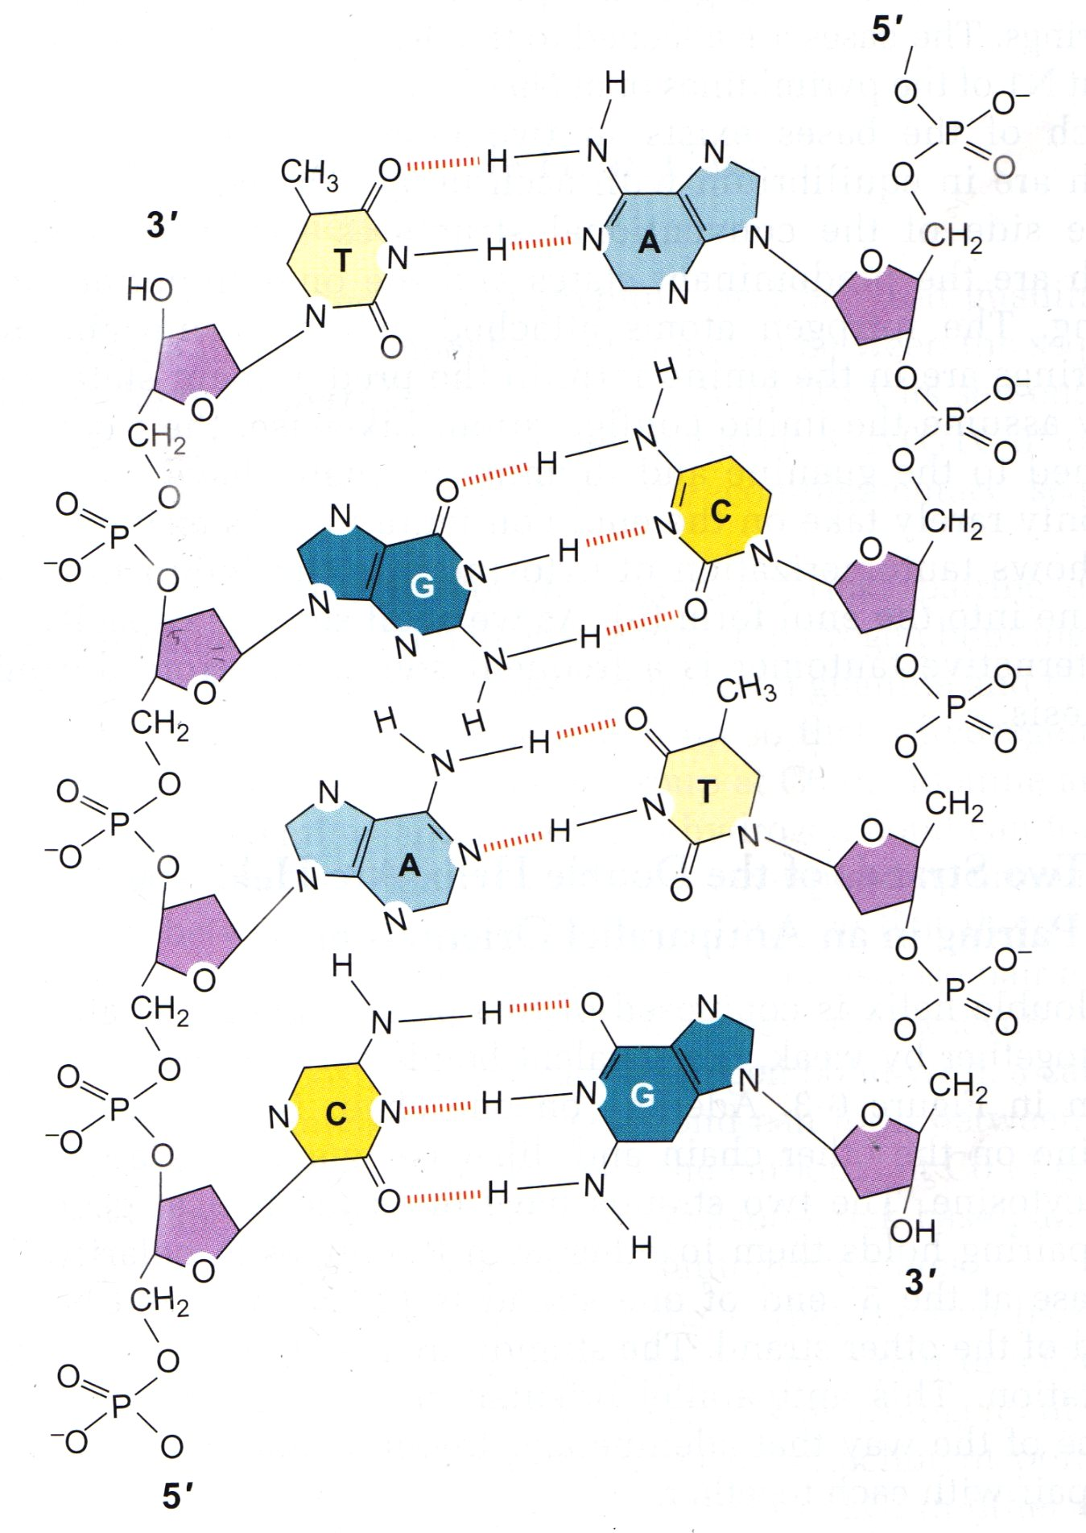
5́ → 3́ directionality
Polarity is defined by the asymmetry
of the nucleotides and the way they
are joined
Notes:
We always read the strand from 5` to 3`. Now which strand is it the right from top to bottom or the left from bottom to left depend on the gene some genes are coded by the sense strand and others by antisense strand

Slide 6
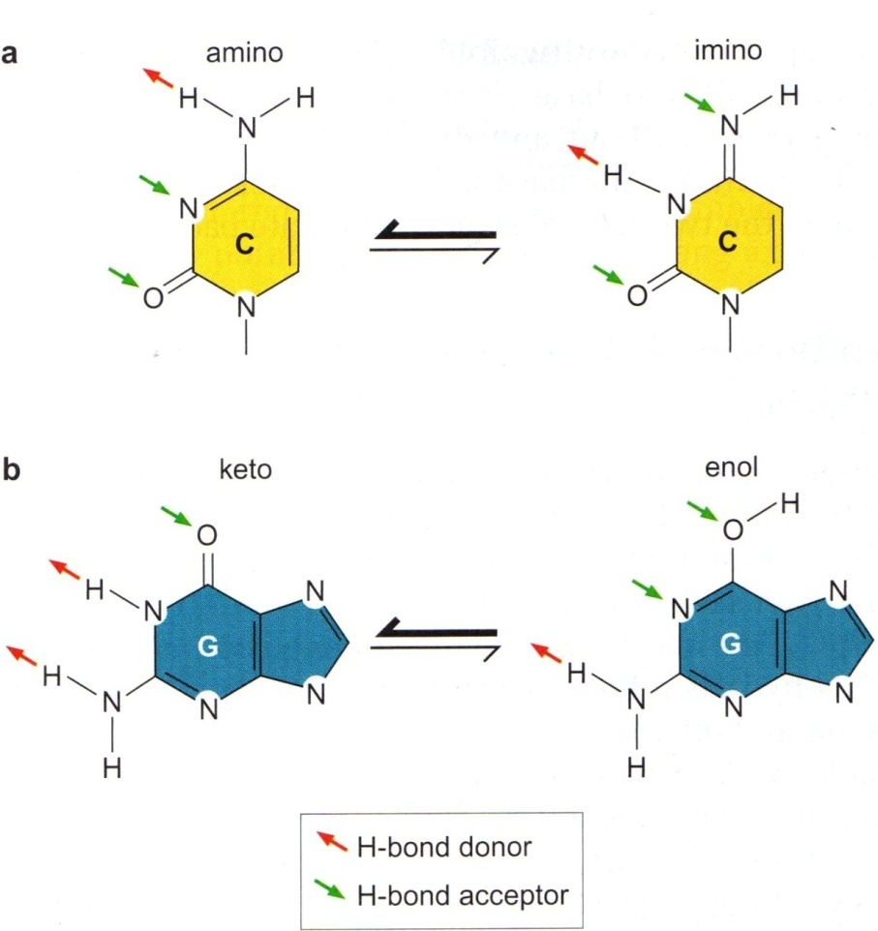
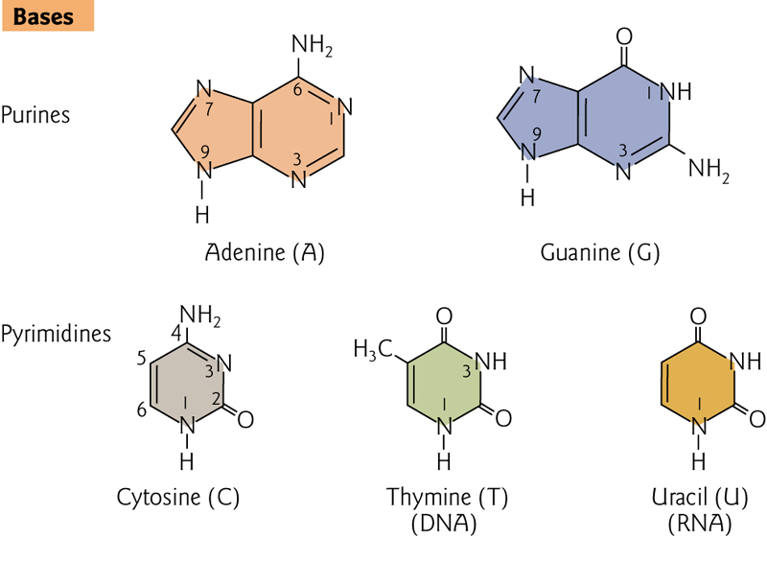
Base Tautomers
Two classes of bases
Preferred tautomeric form
Changing configuration is a source of error during DNA synthesis

Slide 7
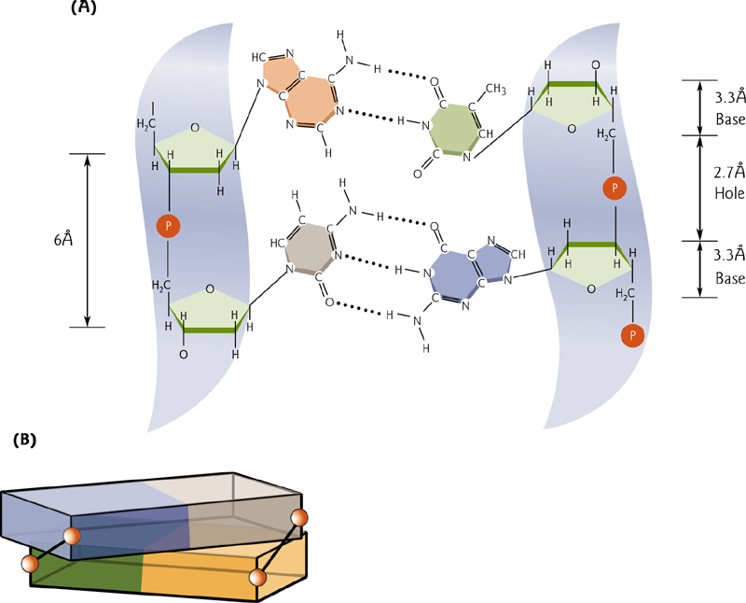
Holding the two strands together
Hydrogen bonding (fundamental to stability and specificity of base pairing)
A=T or G≡C
Hydrophobic bases & hydrophilic backbone
Base stacking
(attractive, noncovalent interactions between aromatic rings)
Notes:
Watson-Crick base-pairing requires that the bases be in their preferred tautomeric states
The two base pairs have exactly the same geometry; having an A:T base pair or G:C base piar between the two sugars does not perturb the arrangment of the sugars because the distance between the sugar attachemnt points are the same for both bases. Niether does T:A or C:G.

Slide 8
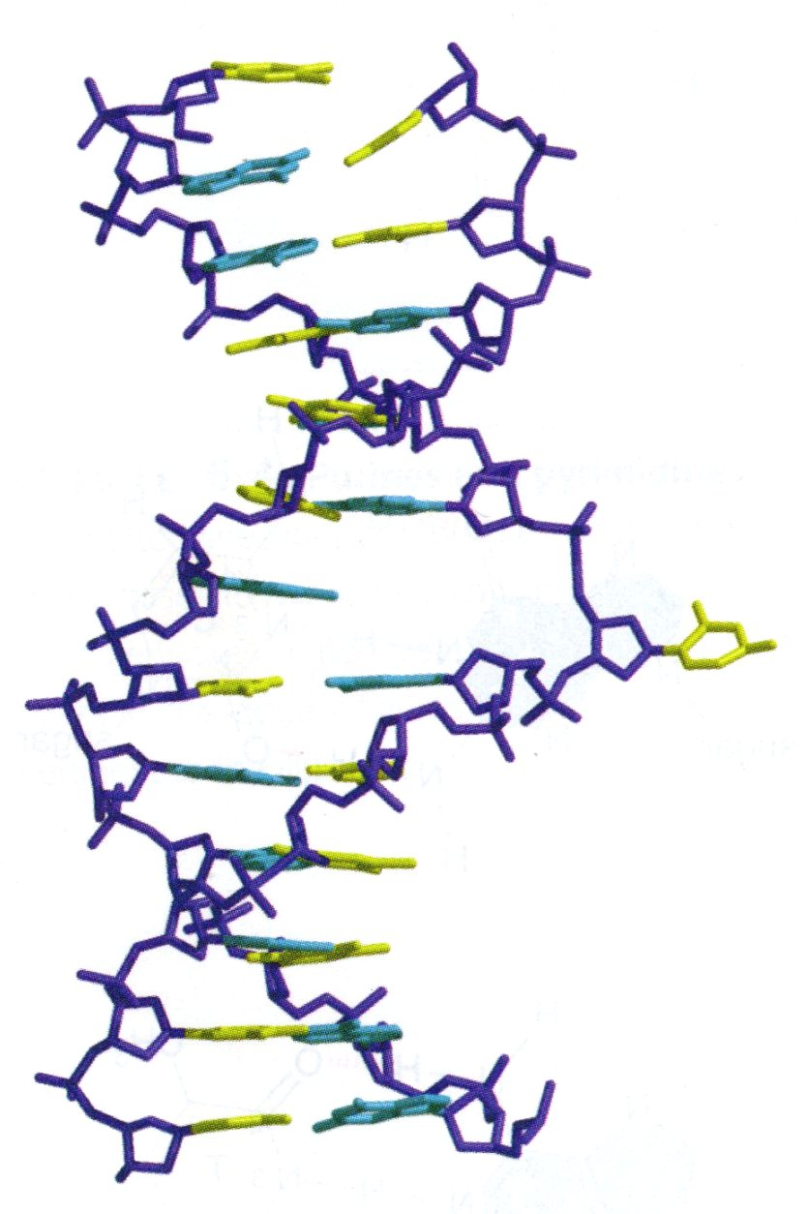
Flipping out of the base
Definition:
protrusion of one base out of the double helix
Importance:
Easy for methylases
Easy to remove damaged bases
Enzymes involved in Homologous Recombination (HR) and repair are believed to scan the DNA for homology or lesions by flipping out one base after another

Slide 9
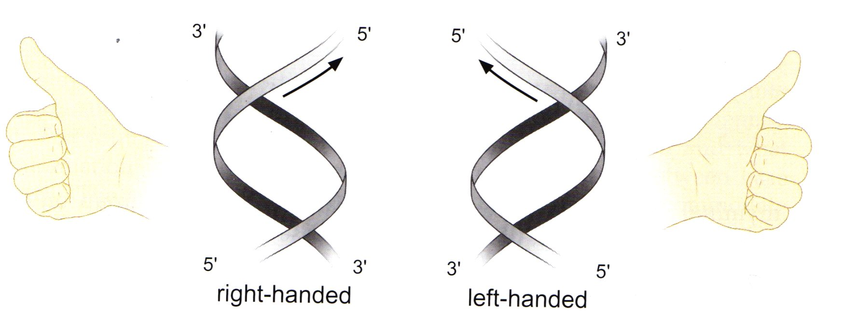
Right handedness (orientation of the helix)
DNA is usually right handed
Periodicity: each base pair is displaced (twisted) from the previous one by ~ 36º

Slide 10
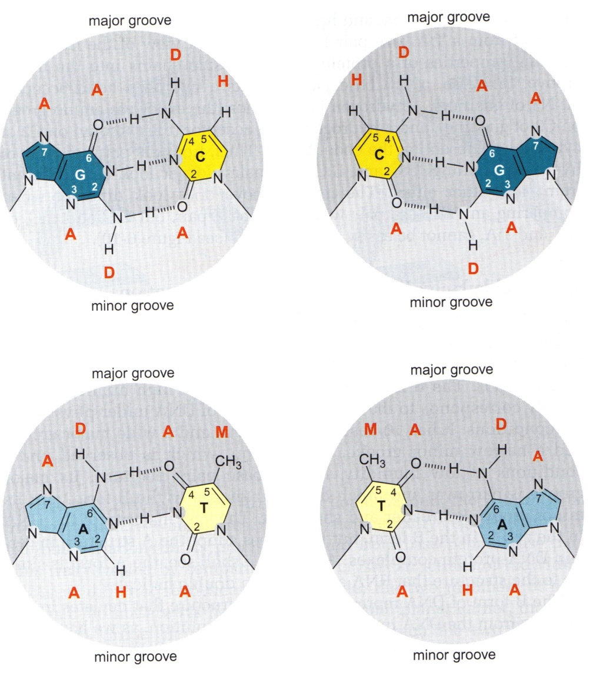
Major & Minor grooves
Caused by the angle between glycosidic bond
Major groove of
A:T is ADAM
G:C is AADH
T:A is MADA
C:G is HDAA
The code specifies the identity of
the base pair
Importance: protein recognition without
opening the helix and breaking double
helix
Minor groove is less informative
Unable to accommodate amino acids due
to small size.
All base pairs looks similar to one another
in the minor groove e.g. A:T code is AHA and
G:C code is ADA

Slide 11
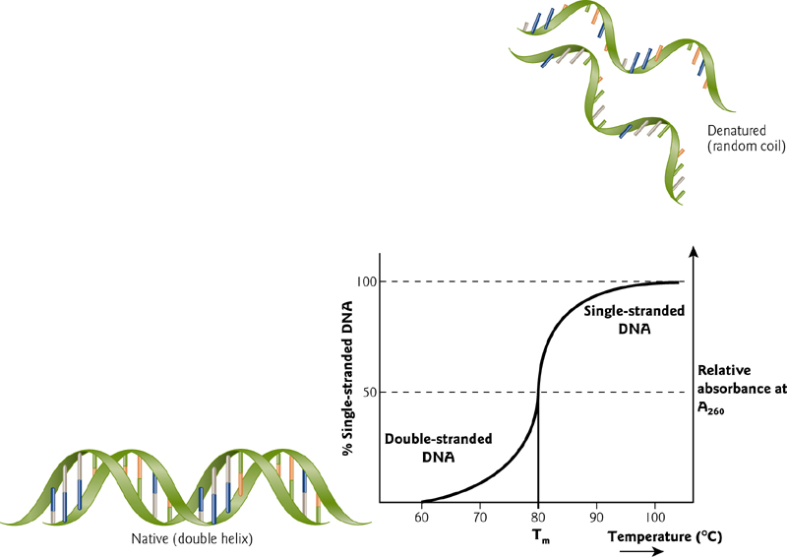
Can denature & re-associate
DNA absorb maximally at 260 nm
Hyperchromic effect: increase in A260 by ~ 40%
Hypochromic effect: low A260 due to base stacking

Slide 12
Melting Temperature (Tm)
Characteristic of each DNA and is determined by:
Length of DNA sequence
GC content
Salt concentration:
in low salt, a given DNA will melt at a lower temperature than in a higher salt concentration. This is because DNA is a polyanionic molecule. The salt "shields" the negative charges on each phosphate. When the charges are NOT shielded, the electrostatic repulsion makes it energetically more favorable to separate the strands.
Hybridization is the basis for several laboratory techniques
PCR
Southern blot
Microarray analysis

Slide 13
DNA different conformation
3 forms of DNA could be detected
B – form (Watson & Crick)
A – form
Z – form (Zigzag)

Slide 14
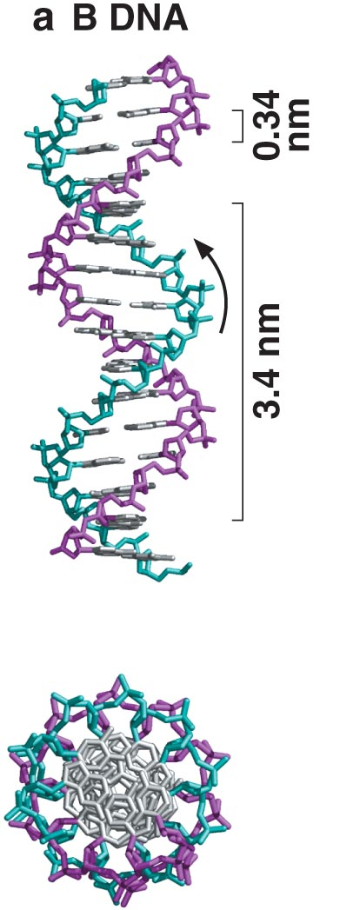
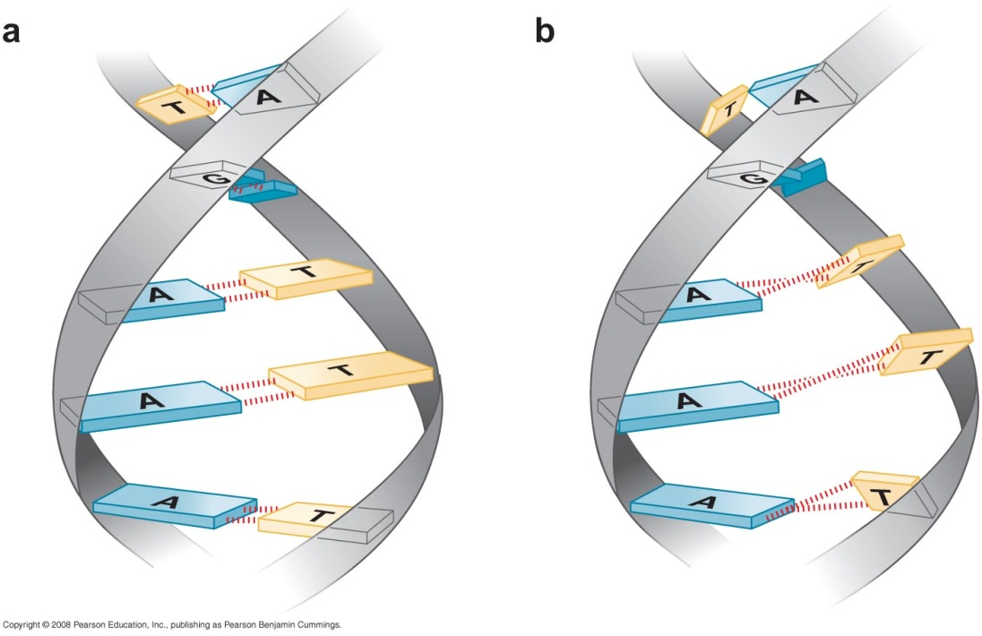
B - Form (Watson & Crick)
10 bp /turn, right-handed
Observed at high humidity
Ideal structure that deviates in two respects from the DNA in cells:
DNA in solution is somewhat more twisted on average than the B from having ~ 10.5 bp /turn
2. The B form is an average structure, whereas real DNA is not perfectly regular. Rather , it exhibits variations in its precise structure from bp to bp
Propeller twist
W-C

Slide 15
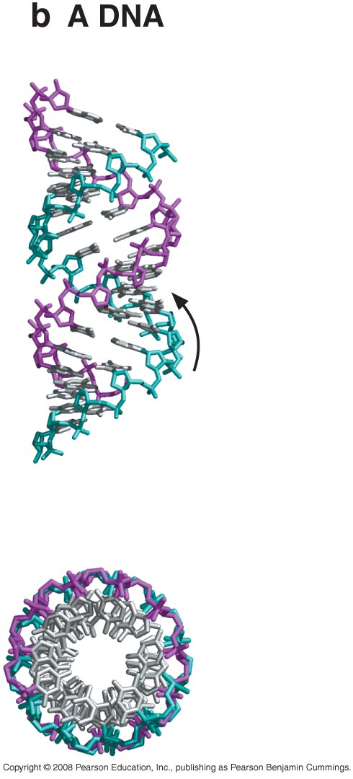
A - Form
11 bp / turn, right-handed
Observed in conditions of low humidity
Adopted in certain DNA-protein complexes
Similar to the structure that RNA
adopts when double helical

Slide 16
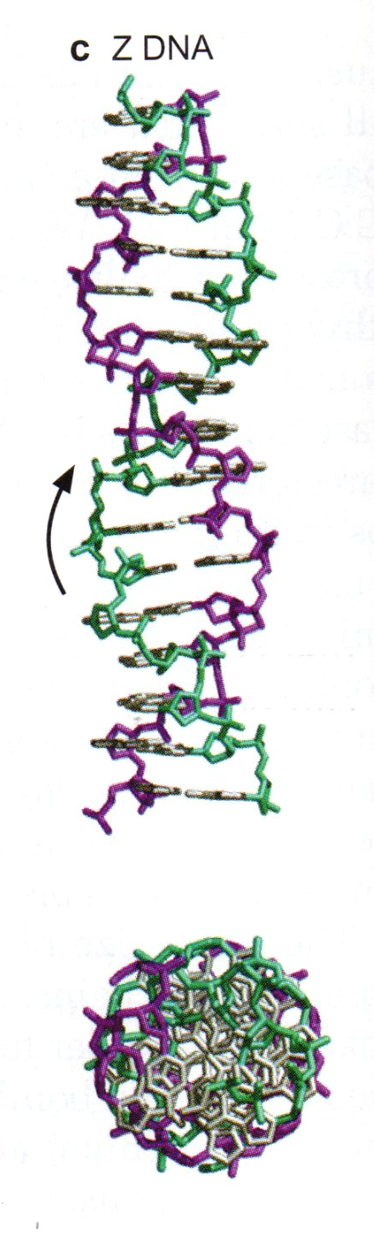
Z - Form (ZigZag)
Present at short sections of DNA
Left handed
12 bp/turn
Major groove very shallow (doesn’t exist)
Deep narrow minor groove

Slide 17
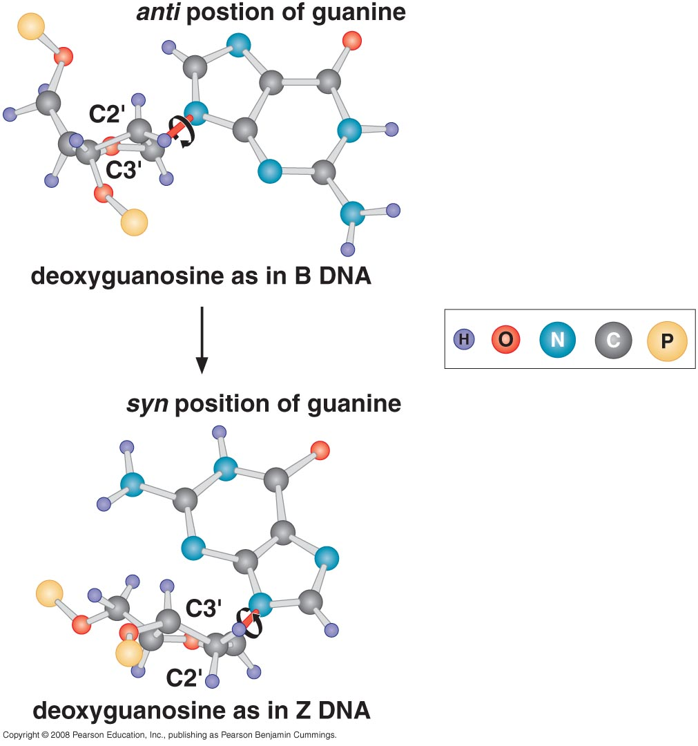
How Z DNA is formed?
In right-handed DNA, the glycosidic bond is always in the anti conformation
In the left-handed helix, the fundamental repeating unit usually is a purine-pyrimidine dinucleotide with the glycosidic bond in the anti-conformation at pyrimidine residues and in the syn conformation at purine residues
Ant-syn conformation gives the backbone of the left-handed DNA a zigzag look
In solution, alternating pu-py assume the left-handed conformation only in the presence of high conc of positively charged ions that shield the phosphate groups.
Notes:
The image shows a characteristic feature of Z-DNA, where the anti-syn conformation of the nucleotides gives the DNA backbone its distinctive zigzag appearance. This is a hallmark of Z-DNA, which is different from the smoother, right-handed helix of B-DNA.
In Z-DNA, the purine bases alternate between the anti and syn conformations, contributing to the zigzag pattern. The sugar-phosphate backbone of Z-DNA is twisted in such a way that it creates a left-handed helix, in contrast to the right-handed B-DNA. This structural conformation typically forms in sequences with alternating purines and pyrimidines (pu-py), and under conditions like high salt concentrations or supercoiling, as mentioned earlier.
The anti-syn switching creates a unique geometry, where the phosphate backbone appears kinked or zigzagged, hence the name "Z-DNA." This form can be involved in certain biological processes, including gene expression regulation, and it can occur transiently under physiological conditions.
The syn conformation refers to the orientation of a nucleotide base (purine or pyrimidine) relative to the sugar-phosphate backbone in the DNA molecule. In this conformation, the base is positioned directly over the sugar ring, creating a compact structure.
Here's a more detailed explanation of the syn conformation and its significance:
1. Base Orientation
In DNA, the nitrogenous bases (adenine, guanine, cytosine, thymine) can adopt different orientations relative to the sugar (deoxyribose) in the nucleotide.
In the syn conformation, the base is rotated such that it is positioned over the sugar ring, with the N-glycosidic bond (the bond between the sugar and the base) being oriented in such a way that the base "covers" the sugar.
2. Anti vs. Syn Conformation
DNA nucleotides can exist in two main conformations relative to the sugar-phosphate backbone:
Anti conformation: The base is rotated away from the sugar, which is the most common and stable conformation in right-handed B-DNA.
Syn conformation: The base is rotated over the sugar ring, a conformation that is less common and more energetically strained, but it is a defining feature of Z-DNA (left-handed DNA).
3. Z-DNA and the Role of Syn Conformation
In Z-DNA, alternating purine bases (like guanine) adopt the syn conformation, while pyrimidines (like cytosine) remain in the anti conformation. This alternating syn-anti pattern gives Z-DNA its zigzag backbone structure.
This is unique compared to the anti conformation that dominates in the more common B-DNA form.
4. Biological Relevance
The syn conformation occurs under specific conditions, such as high ionic strength or supercoiling, leading to the formation of Z-DNA.
While B-DNA is the prevalent form of DNA in cells, Z-DNA and the syn conformation play roles in regulating gene expression, DNA repair, and recombination, particularly in regions of the genome that are highly dynamic or prone to stress.
In summary, the syn conformation is when a nucleotide's base is aligned over the sugar, contrasting with the more common anti conformation, and is crucial for forming the unique left-handed Z-DNA structure.

Slide 18
Circular DNA
Eukaryotic chromosomes have linear DNA with two free ends
Most bacterial DNA, DNA of small viruses and free plasmids all have circular DNA
Some DNA molecules are sometimes linear and sometimes circular e.g. phage

Slide 19
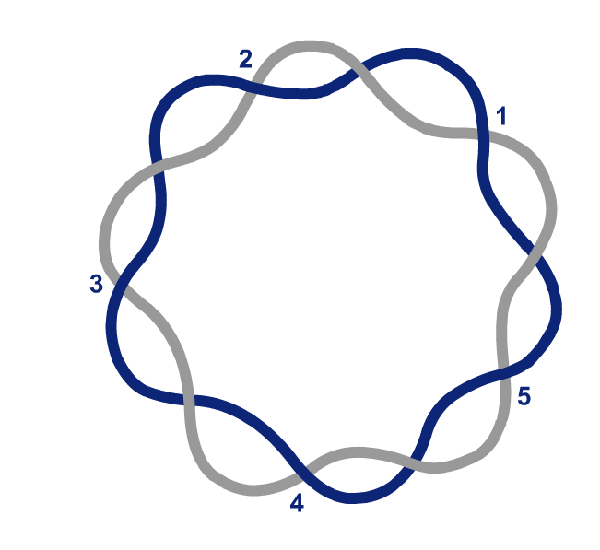
DNA Topology
DNA is a flexible structure, its exact parameters are a function of both the surrounding ionic environment and the nature of the DNA-binding proteins with which it is complexed
Linear DNA can freely rotate to accommodate changes in the number of times the two chains of the double helix twist about each other

Slide 20
But if the two ends are covalently linked to form a circular DNA molecule (cccDNA) then the absolute number of times the chains can twist about each other cannot change
DNA is constrained (can’t unwind freely)
Despite these constraints, DNA participates in numerous dynamic processes in the cell (transcription and replication).

Slide 21
Linking number of covalently closed circular DNA
Because there are no interruptions in either polynucleotide chain, the two strands of cccDNA cannot be separated from each other without the breaking of a covalent bond
If we wish to separate the two circular strands without permanently breaking any bonds in the sugar-phosphate backbones, we would have to pass one strand through the other strand repeatedly
The number of times one strand would have to be passed through the other strand for the two strands to be entirely separated from each other is called the linking number
The linking number is the sum of two geometric components called twist and writhe

Slide 22
To clarify the concept of linking number (Lk), twist (Tw), and writhe (Wr) in circular DNA, let’s break it down with an example.
Definitions:
Linking Number (Lk): The total number of times one strand of DNA wraps around the other in a circular DNA molecule. It's the sum of twist and writhe:
Lk=Tw+WrLk = Tw + WrLk=Tw+Wr
Twist (Tw): This represents how many times the two DNA strands twist around each other in a helical manner. In relaxed B-DNA, for example, there are about 10.5 base pairs per turn of the helix.
Writhe (Wr): This refers to the number of times the DNA double helix crosses over itself in space, which creates supercoiling. It can be positive (overwound) or negative (underwound).

Slide 23
Example:
Imagine a circular DNA molecule that contains 210 base pairs. If this DNA is in its relaxed state (no supercoiling), the twist would be:
Tw=210 base pairs/10.5 base pairs per turn=20
So, in this relaxed state, the linking number would simply be the twist:
Lk=Tw=20, Lk = Tw = 20Lk=Tw=20
If there is no writhe, the linking number is equal to the twist.

Slide 24
Introducing Supercoiling:
Now, let’s assume the DNA becomes underwound, meaning that there is less twisting than normal, and supercoiling is introduced. If we remove two turns, the twist becomes:
Tw=18Tw = 18Tw=18To maintain the linking number (which remains constant unless covalent bonds are broken), the molecule compensates by introducing negative supercoils. The writhe would now be:
Wr=Lk−Tw=20−18=+2 (negative supercoils)Wr = Lk - Tw = 20 - 18 = +2 \, \text{(negative supercoils)}Wr=Lk−Tw=20−18=+2(negative supercoils)
Thus, the molecule introduces writhe (supercoiling) to maintain the overall linking number of 20.
Key Concept:
In this example, if you wanted to completely separate the two strands without breaking any bonds, you would need to pass one strand through the other 20 times, because the linking number (Lk) is 20. This is what the linking number represents: the number of passes required to separate the strands of a circular DNA molecule.

Slide 25
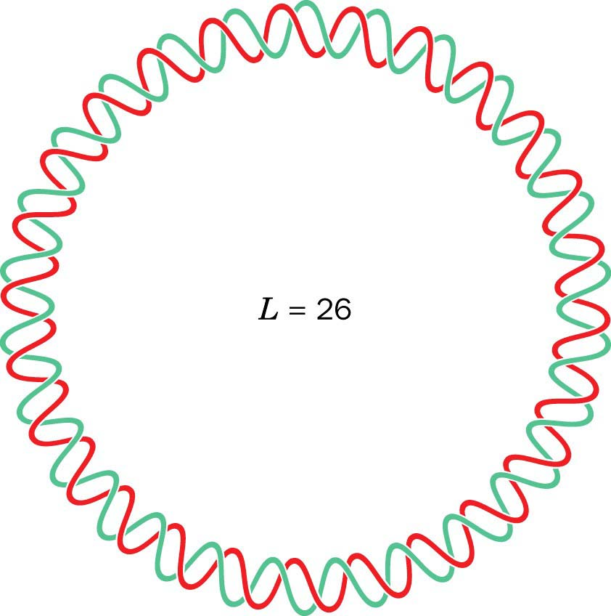
Twist (Tw)
The helical turns of one strand of DNA about the other i.e. the number of times one strand completely wraps around the other strand
The helical twists in a right-handed helix are defined as positive such that the LK of DNA will have positive value

Slide 26
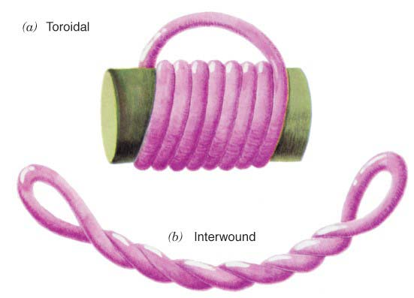
Writhe
Torsional stress of the DNA in which DNA double helix crosses over itself in 3 dimensional space
Two forms
Spiral (Toroid)
Interwound (plectonemic)
Right-handed interwound turns are assigned negative writhing numbers
If right-handed DNA writhes to form a left-handed interwound helix, the twisting number of the DNA decreases. Therefore, left-handed interwound turns are assigned positive writhing numbers

Slide 27

Writhing number (Wr)
is the total number of interwound / spiral writhes in cccDNA
Interwound and spiral writhes are topologically equivalent to each other and are readily interconvertible geometric properties of cccDNA
Twist and writhe are interconvertible
The only constraint is that the sum of the twist number and writhing number must remain equal to the linking number
LK=Tw + Wr
Wr = +3

Slide 28
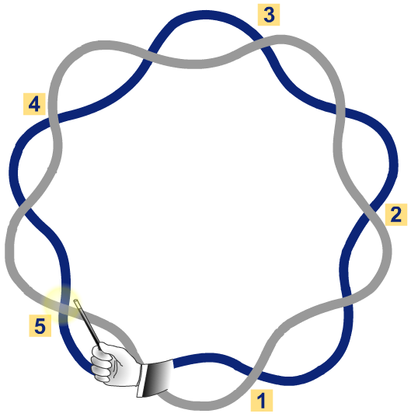
Linking number (Lk)
The number of times one strand would have to be passed through the other strand in order for the two strands to be entirely separated from each other
Lk = 5

Slide 29
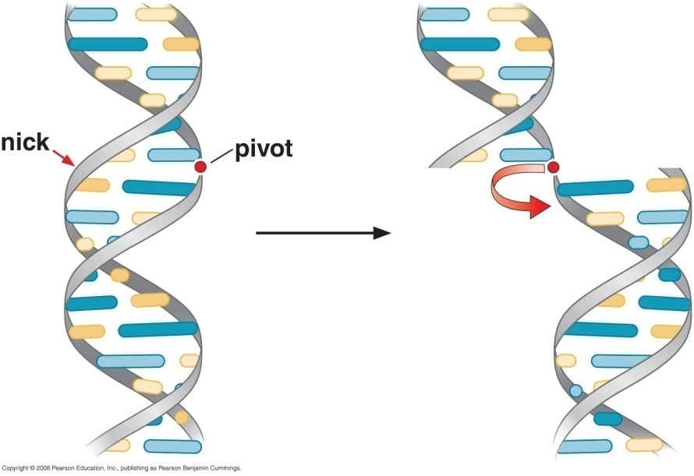
Linking number under physiological conditions (Lk°)
Lk of cccDNA under physiological conditions
DNA is completely relaxed (free of supercoiling
Lk° is the number of bp divided by 10.5 (bp/turn)
Supercoils of DNA can be relaxed by mild treatment with DNAse I
which breaks on average one phosphodiester bond in each DNA molecule

Slide 30
Linking number (Lk)
Lk = Tw + Wr
No supercoiling (Wr = 0) → Lk = Tw
Lk = Tw = 5

Slide 31
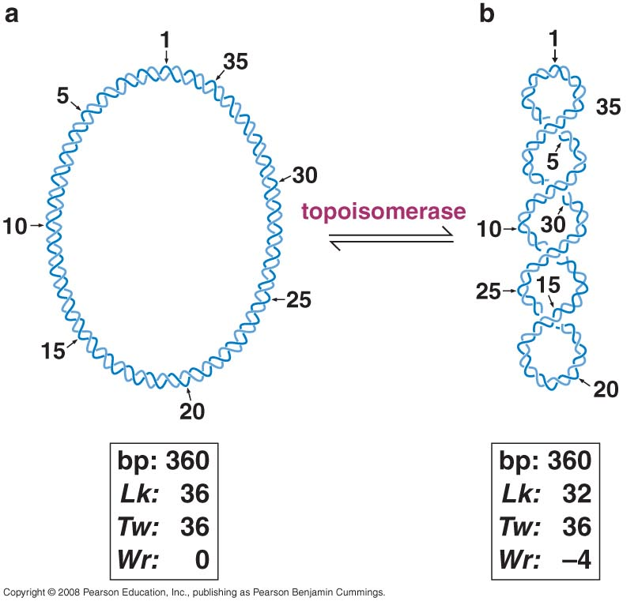
Lk = Tw + Wr

Slide 32
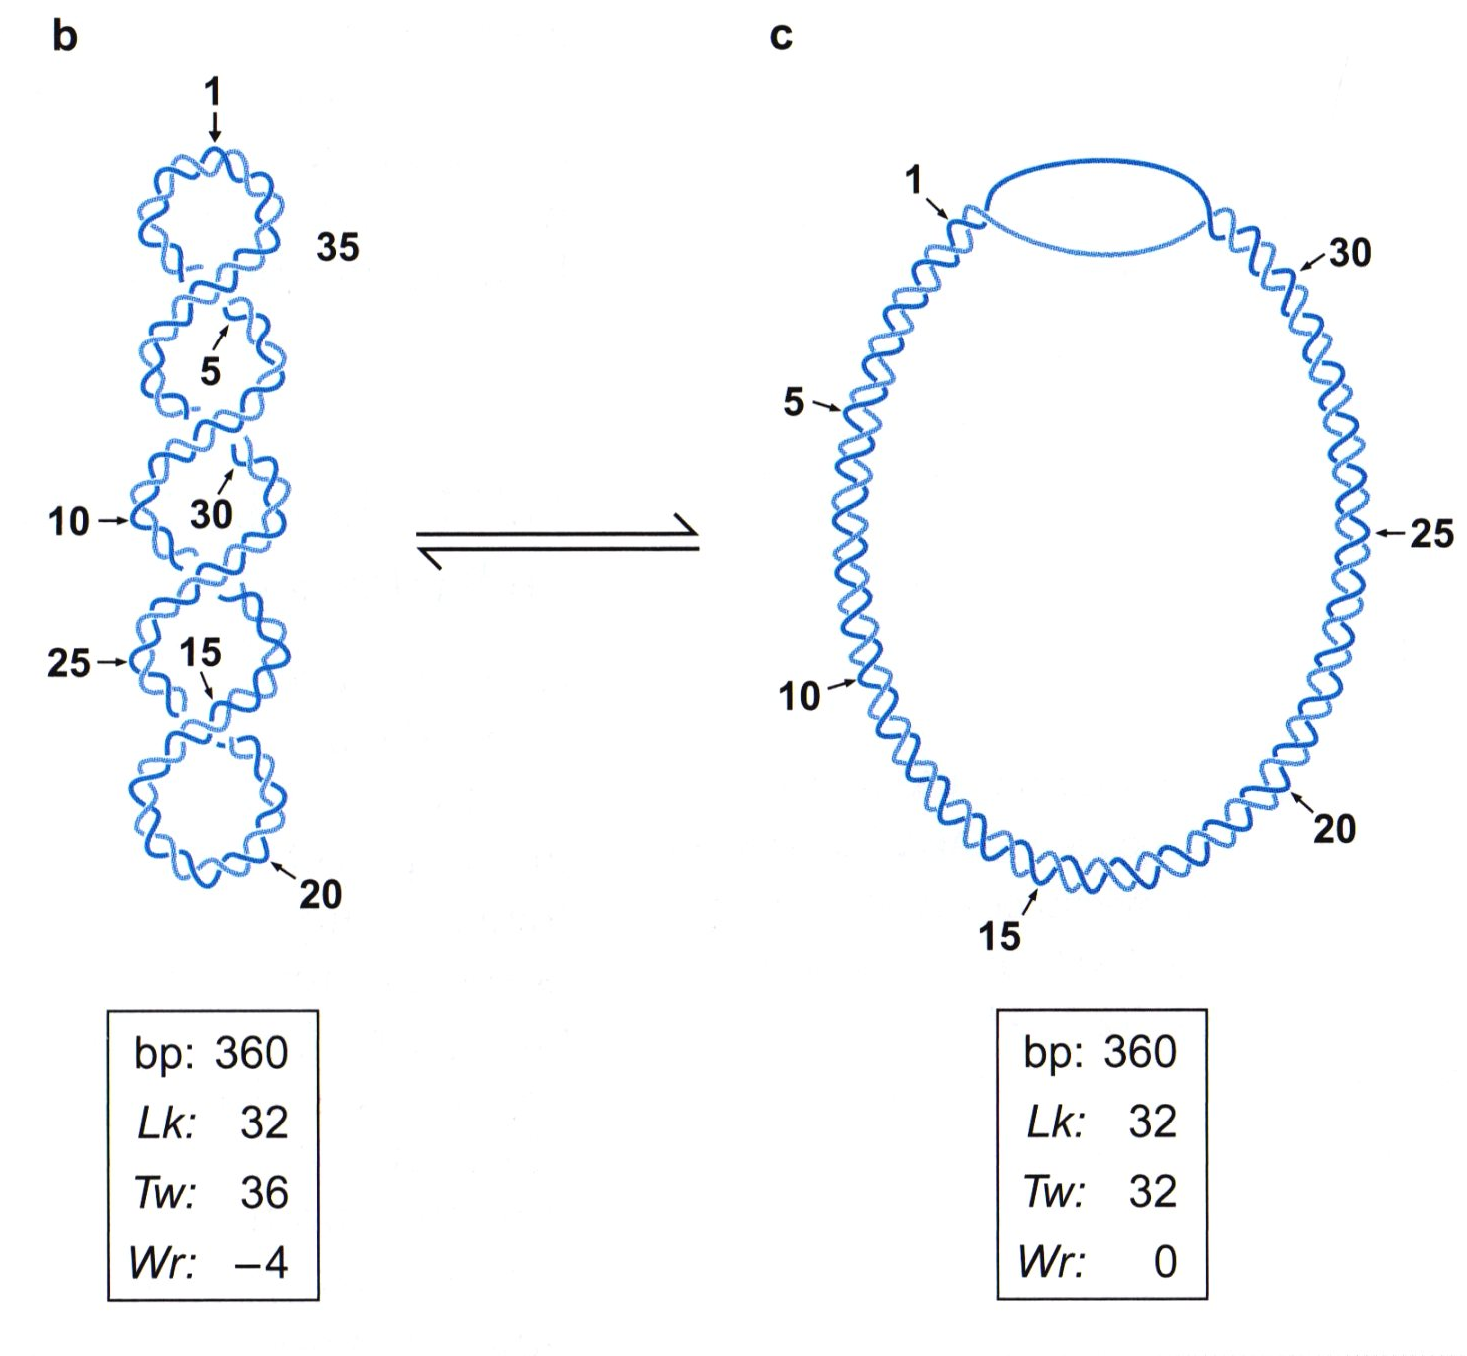
Writhe can convert to twist and vice versa
LK = Wr + Tw
Negatively supercoiled

Slide 33
DNA in cells is negatively supercoiled
The extent of supercoiling is measured by linking difference
ΔLk = Lk - Lk°
If ΔLk of a cccDNA is significantly different from 0, then the DNA is torsionally strained and hence is it is supercoiled
If Lk < Lkº and ΔLk < 0, then the DNA is negatively supercoiled
If Lk > Lkº and ΔLk > 0 then DNA is positively supercoiled
To compare two different molecules with different LK, we use superhelical density
σ = ΔLk/ Lk°
Circular DNA purified from bacteria and eukaryotes are usually negatively supercoiled having σ of -0.06

Slide 34
"Nucleosomes" are the basic structural units of chromatin in eukaryotic cells. They consist of a segment of DNA wound around a core of eight histone proteins, forming a bead-like structure. This configuration helps in packaging long DNA strands into a more compact form, allowing them to fit within the cell nucleus while still being accessible for transcription, replication, and repair processes.

Slide 35
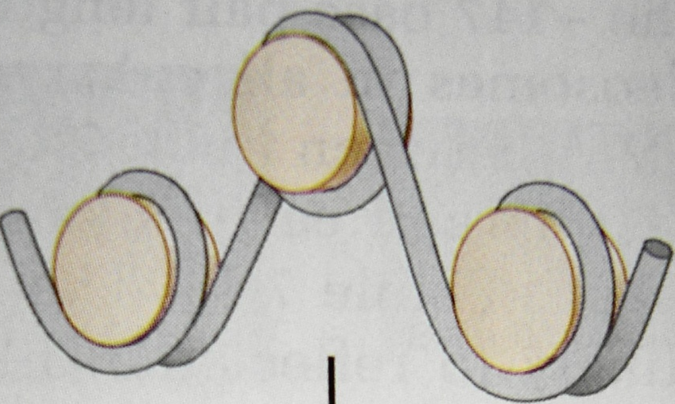
Nucleosomes introduce negative supercoiling in Eukaryotes
Spiral (Toroid) writhe
Left handed spiral turns
Wr number is –ve
Allow for replication / transcription

Slide 36
Topoisomerase can relax supercoiled DNA
Topoisoermase I:
Topoisoerase II:

Slide 37
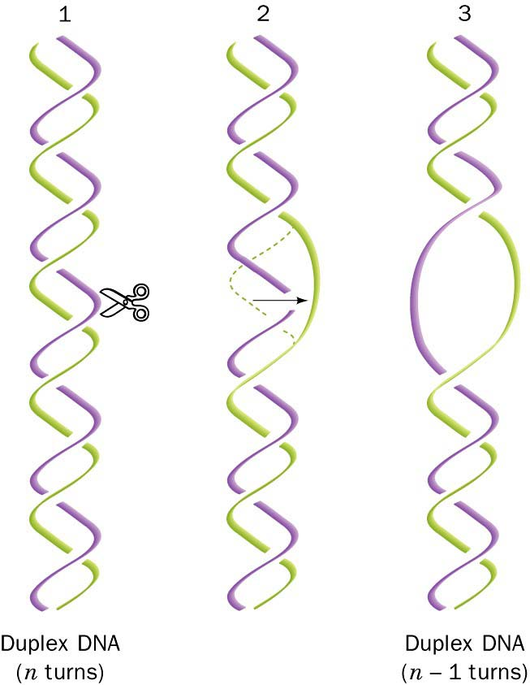
Topoisoermase I
Causes a transient single - strand break
Changes Lk number by 1
Doesn’t need energy

Slide 38
Both prokaryotes and eukaryotes have type I and type II topoisomerases
Prokaryotes have a special type II topoisomerase called DNA gyrase that introduces rather than removes negative supercoils
Negative supercoils facilitates the unwinding of the DNA duplex

Slide 39
Topoisoemarse also unknot and disentangle DNA molecules
They can catenate (if linked together)and decatenate circular DNA
Catenated DNA are produced as a round of DNA replication is finished
Topoisoemarse play an important role of unlinking these DNA molecules to allow them to separate into the two daughter cells for cell division
Usually carried by type II enzyme but can be done by type I if one of the two catenated DNA molecules carries a nick of gap
Linear DNA can be entangled during replication of eukaryotic DNA and can be disentangled by type II
On occasion, DNA molecule becomes knotted and can be untied by type II or type I enzymes

Slide 40
Topoisomerase uses covalent protein DNA linkage to cleave and rejoin DNA strands
Topoisomerases are able to promote both DNA cleavage and rejoining without the assistance of other proteins or high-energy cofactors (ATP) because they use a covalent-intermediate mechanism.
DNA cleavage occurs when a tyrosine residue in the active site of the topoisomerase attacks a phosphodiester bond in the backbone of the target DNA. This attack generates a break in the DNA, whereby the topoisomerase is covalently joined to one of the broken ends via a phosphotyrosine linkage. The other end of the DNA terminates with a free OH group
The phospho-tyrosine linkage conserves the energy of the phosphodiester bond that was cleaved. Therefore, the DNA can be resealed simply by reversing the original reaction: the OH group from one broken DNA end attacks the phospho-tyrosine bond re-forming the DNA phosphodiester bond. This reaction rejoins the DNA strand and releases the topoisomerase, which can catalyze another reaction cycle.

Slide 41
Between the steps of DNA cleavage and DNA rejoining, the topoisomerase promotes the passage of a second segment of DNA through the break.
Topoisomerase function thus requires that DNA cleavage, strand passage, and DNA rejoining occur in a highly coordinated manner.
Melting of the DNA strands is favored in highly negatively supercoiled DNA, making the DNA an excellent substrate for relaxation.

Slide 42
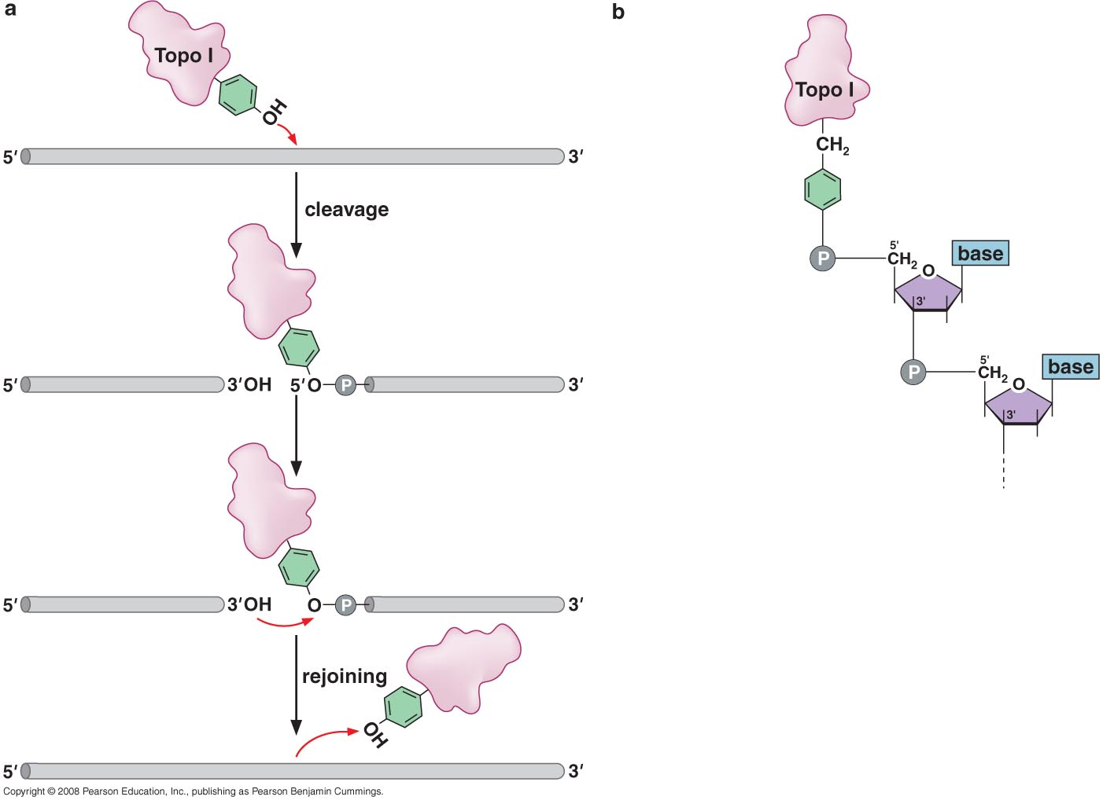
Topoisomerase use covalent protein DNA linkage to cleave and rejoin DNA strands
Phosphate tyrosine bond
Notes:
Topoisomerases are able to promote both DNA cleavage and rejoining without the assistance of other proteins or high energy cofactors (ATP) because they use a covalent-intermediate mechanism.
DNA cleavage occurs when a tyrosine residue in the active site of the topoisomerase attacks a phosphodiester bond in the backbone of the target DNA. This attack generates a break in the DNA, whereby the topoisomerase is covalently joined to one of the broken ends via a phosphotyrosine linkage. The other end of the DNA terminates with a free OH group
The phospho-tyrosine linkage conserves the energy of the phosphodiester bond that was cleaved. Therefore, the DNA can be resealed simply by reversing the original reaction: the OH group from one broken DNA end attacks the phospho-tyrosine bond re-forming the DNA phosphodiester bond. This reaction rejoins the DNA strand and releases the topoisomerase, which can go on to catalyze another reaction cycle.
Between the steps of DNA cleavage and DNA rejoining, the topoisomerase promotes passage of a second segment of DNA through the break.
Topoisomerase function thus requires that DNA cleavage, strand passage and DNA rejoining all occur in a highly coordinated manner.
Melting of the DNA strands is favored in highly negatively supercoiled DNA, making the DNA an excellent substrate for relaxation

Slide 43
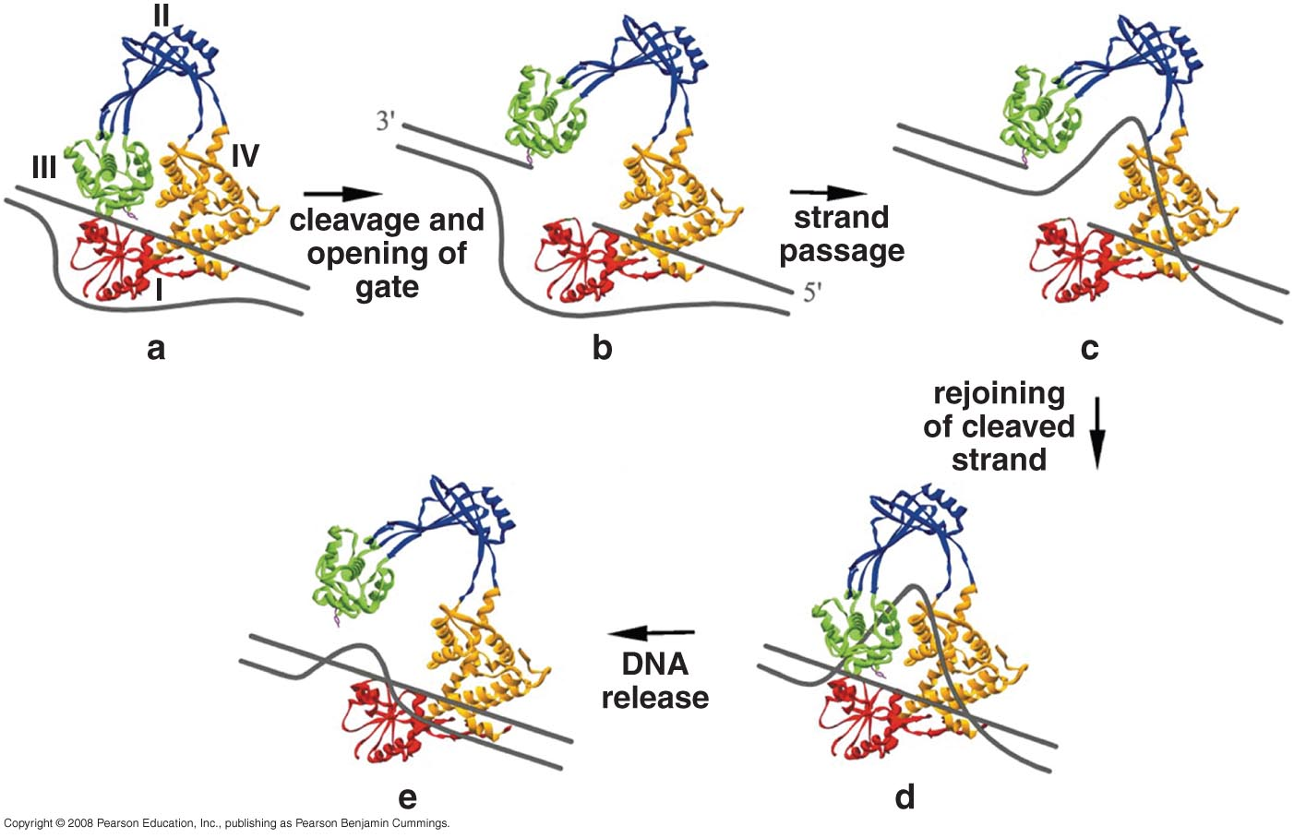
Topisomerase I action in details

Slide 44
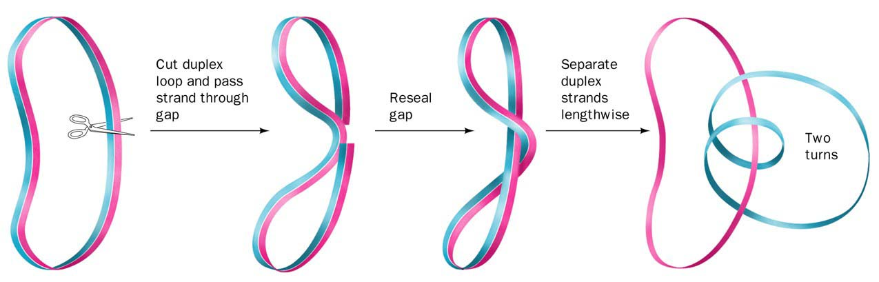
Topoisoermase II
Dimeric protein
Involves tyrosine in the active site

Slide 45
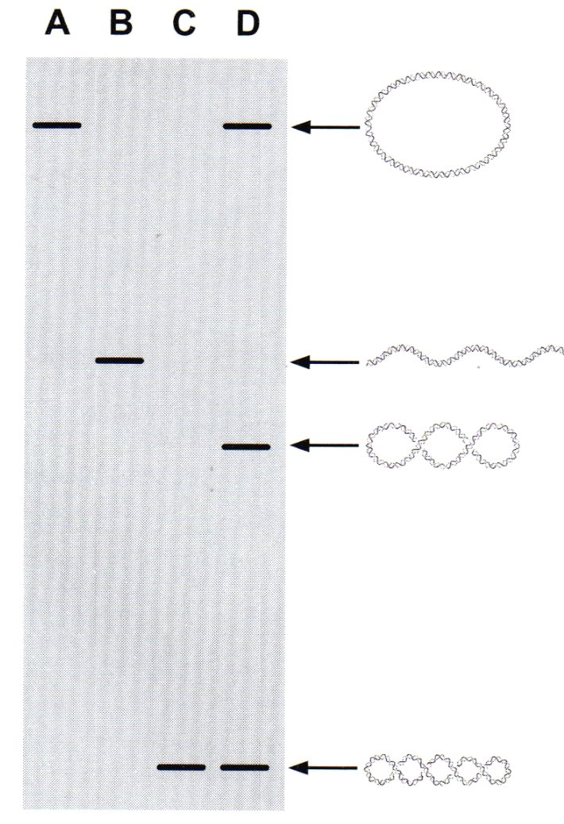
DNA Topoisomers
Schematic of electrophoretic separation of DNA topoisomers.
(Lane A) Relaxed or nicked circular DNA
(lane B) linear DNA
(lane C) highly supercoiled
cccDNA
(lane D) a ladder of topoisomers
Notes:
In electrophoresis, the movement of DNA is influenced by its conformation due to differences in size and compactness. Based on your image:
Lane A (Relaxed or Nicked Circular DNA): This DNA moves slower in the gel because it is less compact compared to supercoiled forms. The relaxed structure makes it larger and less efficient at moving through the pores of the gel.
Lane B (Linear DNA): Linear DNA migrates at a rate dependent on its size. It's less compact than supercoiled DNA but more than relaxed circular DNA, so it moves faster than nicked DNA but slower than highly supercoiled DNA.
Lane C (Highly Supercoiled cccDNA): Supercoiled DNA is the most compact form. It moves fastest through the gel because its tightly wound structure allows it to navigate the pores more efficiently.
Lane D (Ladder of Topoisomers): These are forms of DNA with varying levels of supercoiling. The different degrees of supercoiling result in a "ladder" of bands, with more highly supercoiled forms moving faster and less supercoiled forms moving slower.
In summary, the movement of DNA in your gel reflects the compactness of each form: supercoiled DNA (Lane C) moves the fastest, while relaxed or nicked DNA (Lane A) moves the slowest.

Slide 46
In electrophoresis, the movement of DNA is influenced by its conformation due to differences in size and compactness. Based on your image:
Lane A (Relaxed or Nicked Circular DNA): This DNA moves slower in the gel because it is less compact compared to supercoiled forms. The relaxed structure makes it larger and less efficient at moving through the pores of the gel.
Lane B (Linear DNA): Linear DNA migrates at a rate dependent on its size. It's less compact than supercoiled DNA but more than relaxed circular DNA, so it moves faster than nicked DNA but slower than highly supercoiled DNA.
Lane C (Highly Supercoiled cccDNA): Supercoiled DNA is the most compact form. It moves fastest through the gel because its tightly wound structure allows it to navigate the pores more efficiently.
Lane D (Ladder of Topoisomers): These are forms of DNA with varying levels of supercoiling. The different degrees of supercoiling result in a "ladder" of bands, with more highly supercoiled forms moving faster and less supercoiled forms moving slower.
In summary, the movement of DNA in your gel reflects the compactness of each form: supercoiled DNA (Lane C) moves the fastest, while relaxed or nicked DNA (Lane A) moves the slowest.

Slide 47
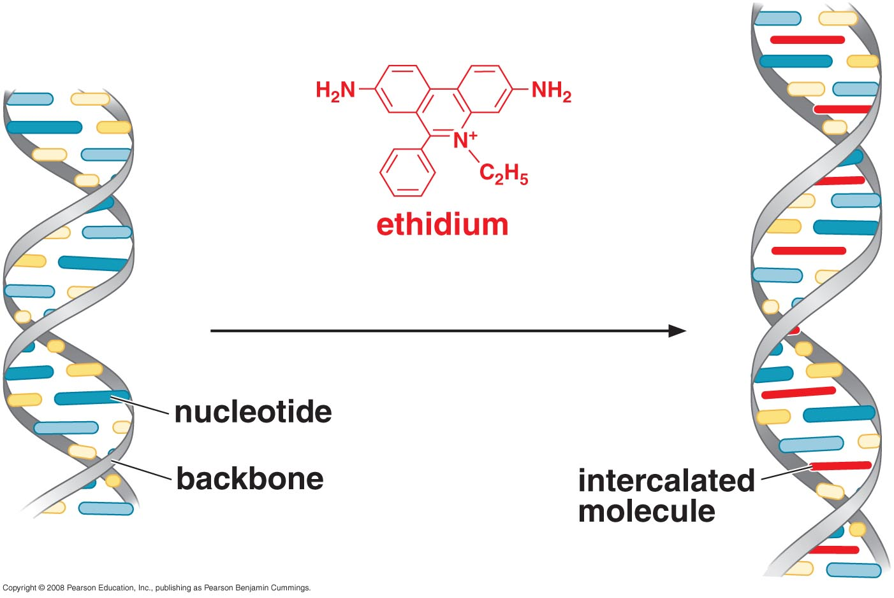
Staining DNA with Ethidium
Causes unwinding of the DNA by 26º reducing the rotation around the bp from 36 to 10º thus decrease the twist of DNA
Negatively supercoiled are more relaxed and migrate slowly but relaxed cccDNA become positively supercoiled and migrate more rapidly
Notes:
Causes unwinding of the DNA by 26º reducing the rotation around the bp from 36 to 10º thus decerase the twist of DNA
Negatively supercoiled are more relaxed and migrate slowly but relaxed cccDNA become positively supercoield and migrate more rapidly

Slide 48
Ethidium bromide (EtBr) is a fluorescent intercalating agent widely used in molecular biology for the visualization of nucleic acids, particularly DNA, in agarose gel electrophoresis. When bound to DNA, EtBr emits bright orange fluorescence under ultraviolet (UV) light, allowing for easy detection and quantification of DNA bands.
Mechanism of Action:
Intercalation: Ethidium bromide intercalates between the base pairs of DNA. This insertion causes a distortion in the DNA structure, which can slightly alter the conformation of the double helix.
Fluorescence: Upon excitation by UV light (typically at a wavelength of 260 nm), EtBr emits light at a wavelength of approximately 590 nm. This fluorescence is what allows for visualization of the DNA.

Slide 49
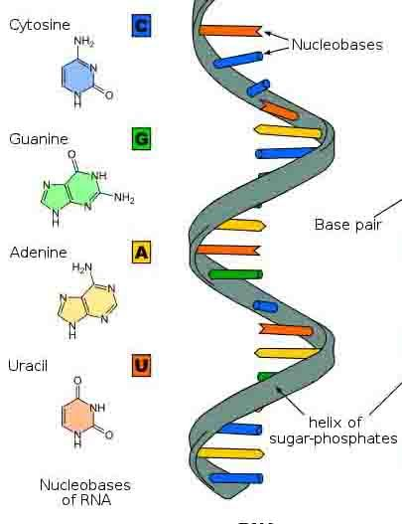
RNA Structure

Slide 50
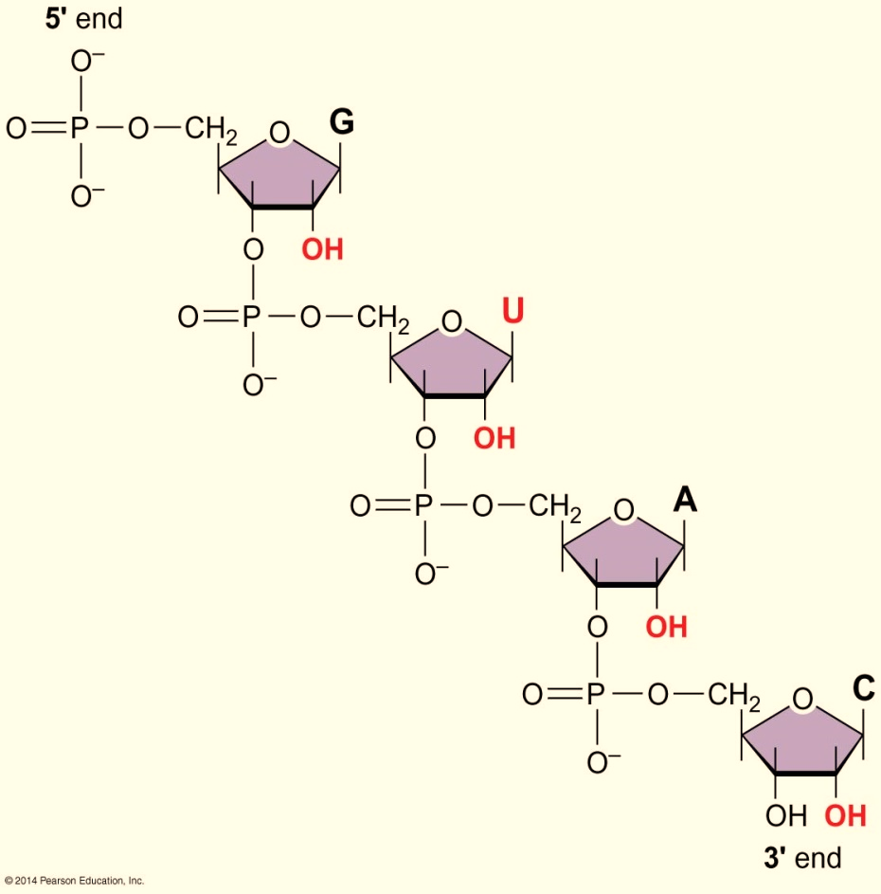
Basic RNA Structure
Ribose instead of 2`- deoxyribose
Uracil instead of Thymine
Single nucleotide chain
Genetic material in certain viruses
Intermediate mRNA
Adapter tRNA
Structural rRNA
Regulatory
Ribozyme

Slide 51
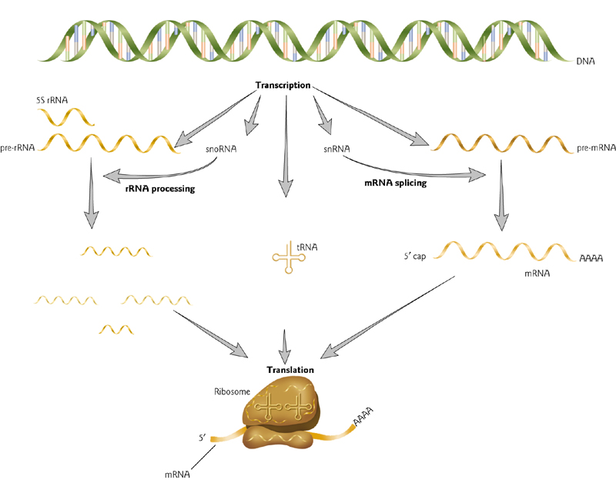
RNA functions

Slide 52
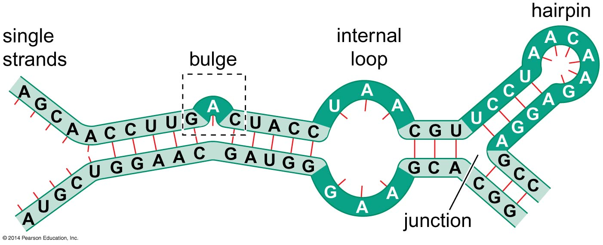
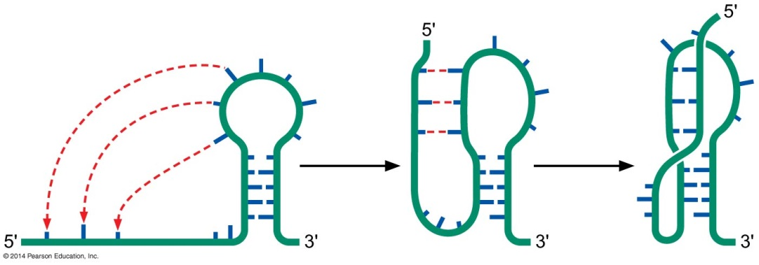
Secondary RNA structure
Because of
Watson-Crick pairing
Non-canonical pairing
Stem-loop types:
Hairpin
Bulge
Loop
Stability is enhanced by base-stacking in the loop e.g. UUCG
Pseudoknots: between non-contiguous sequences
Non-contiguous sequences refer to segments of nucleotides within a nucleic acid (such as RNA) that are not adjacent to each other in the primary sequence but can interact through base pairing to form secondary structures, such as pseudoknots or other complex conformations. These sequences may be separated by intervening nucleotides that do not participate in the pairing.

Slide 53
A pseudoknot is a structural motif found in RNA molecules where bases in a loop form hydrogen bonds with complementary bases outside the loop, leading to a more complex 3D structure. It typically involves interactions between a single-stranded loop and a region of double-stranded RNA. This structure can play critical roles in various biological functions, including:
Ribosomal frameshifting: Pseudoknots are known to induce ribosomal pausing, leading to programmed frameshifting during translation.
Telomerase function: Pseudoknots are present in the RNA component of telomerase and contribute to its function in maintaining chromosome ends.
RNA stability: Pseudoknots can stabilize RNA structures and influence their degradation pathways.
In an electrophoresis context, pseudoknots may affect the migration of RNA by adding complexity to its secondary and tertiary structure. This can slow down RNA's movement through the gel, similar to how hairpins or other secondary structures would impact migration.

Slide 54
Watson-Crick Base Pairing:
The standard pairing that occurs in DNA and RNA:
Adenine (A) pairs with Thymine (T) in DNA or Uracil (U) in RNA via two hydrogen bonds.
Guanine (G) pairs with Cytosine (C) via three hydrogen bonds.
These base pairs maintain the double helix structure of DNA, following strict complementarity.
Non-Canonical Pairing:
Refers to interactions between nucleotides that do not follow the standard Watson-Crick rules.
Examples include:
G-U wobble base pairing in RNA, where guanine pairs with uracil.
Hoogsteen base pairs or other alternative hydrogen bonding configurations.
Non-canonical base pairs play a significant role in RNA secondary structures and can affect functions such as gene regulation, RNA splicing, and protein synthesis.

Slide 55
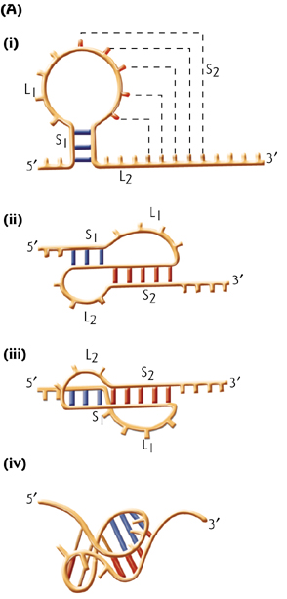
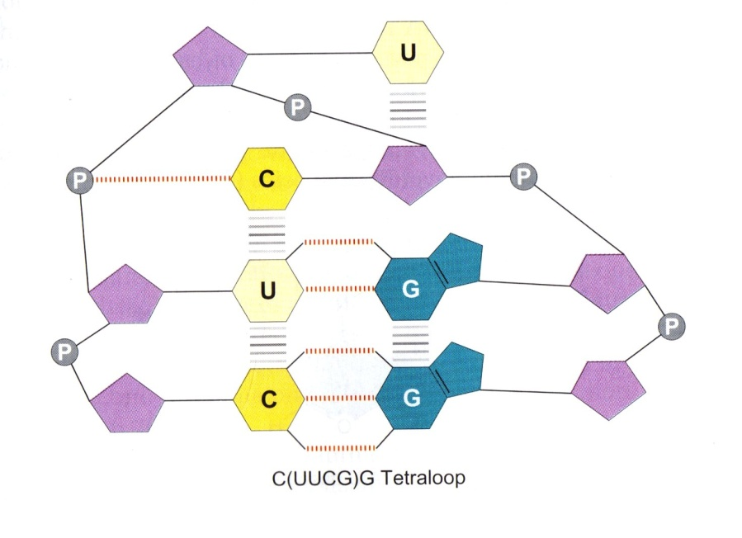
Tetraloop
pseudoknot

Slide 56
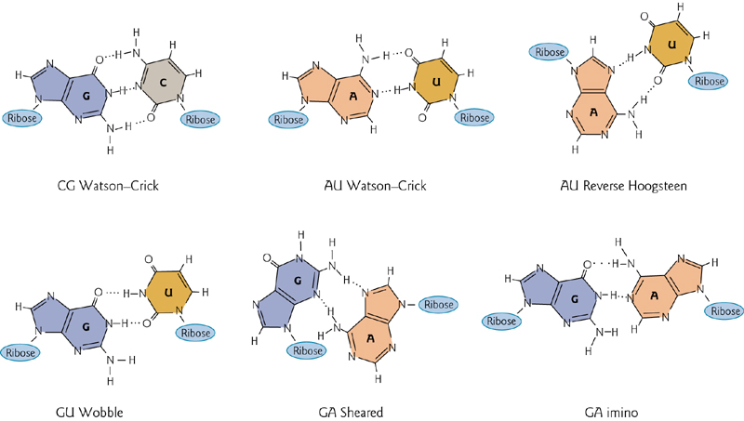
Examples on non-canonical base pairing

Slide 57
Because of the extra GU base-pairing, RNA chains have an enhanced capacity for self-complementarity
The presence of the 2;-hydroxyls in the RNA backbone prevents RNA from adopting a B-form helix. Rather the double-helical RNA resembles the A-form structure of DNA.
Minor groove is wide and shallow and hence accessible. The major groove is so narrow and deep, it is not accessible. Not suitable for binding to proteins.

Slide 58
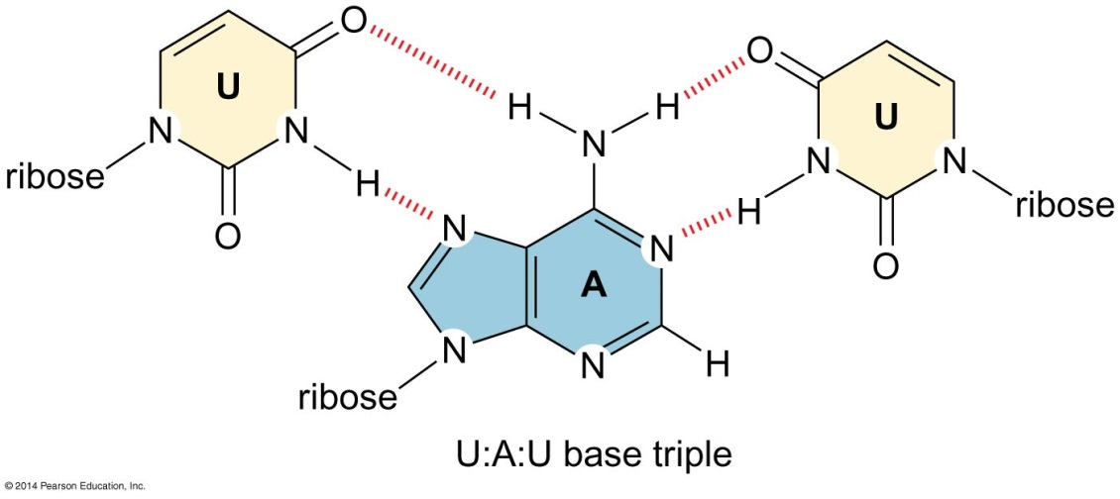
Tertiary RNA structure
RNA has enormous rotational freedom in the backbone of its non-base-paired regions
Formed by:
Hydrogen bonding
Triplet base paring e.g. U:A:U
Interaction of stems with each other
Base stacking
Base modification
Proteins can assist in the formation of a 3 D structure by large RNA molecules such as the ones in ribosomes. Proteins shield the negative charges of phosphates
Synthetic oligoribonucleotides that can be used as affinity to small molecules
Notes:
Proteins can assist in the formation of 3o structure by large RNA molecules such the ones in ribosomes. Proteins shield the negative charges of phosphates
Synthetic oligoribonucleotides that can be used as affinity to small molecules

Slide 59
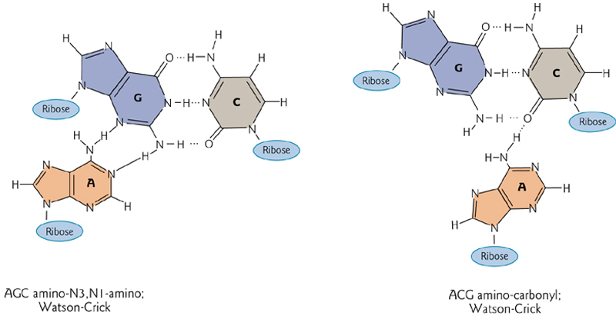

1- Triplet base pairing

Slide 60
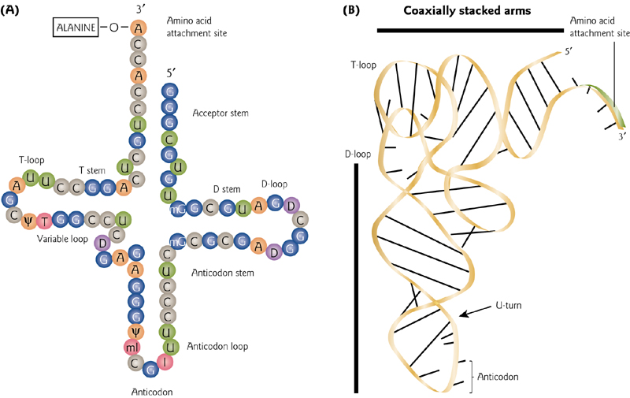
2- Base staking

Slide 61
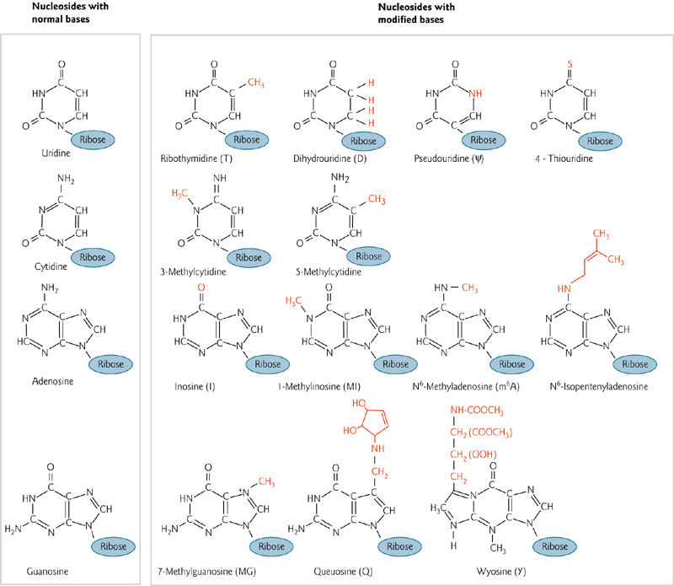
3- Base modification

Slide 62
Some RNA are enzymes (ribozymes)
Have an active site, the binding site for substrate and co-factors like regular enzymes
RNase P, a ribonuclease that is involved in generating tRNA molecules from larger precursor RNAs
Made of RNA and proteins the RNA alone is the catalyst. The protein facilitates the reaction by shielding the negative charge on the RNA so it can bind effectively to the negatively charged substrate
Other ribozymes carry out transesterification reactions involved in the removal of introns from precursor mRNAs (RNA splicing)

Slide 63
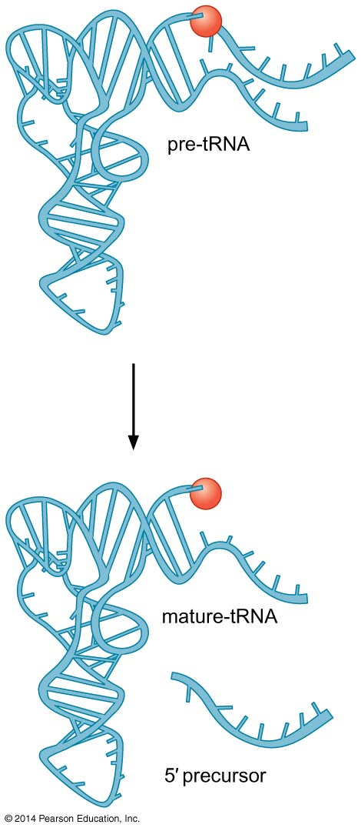
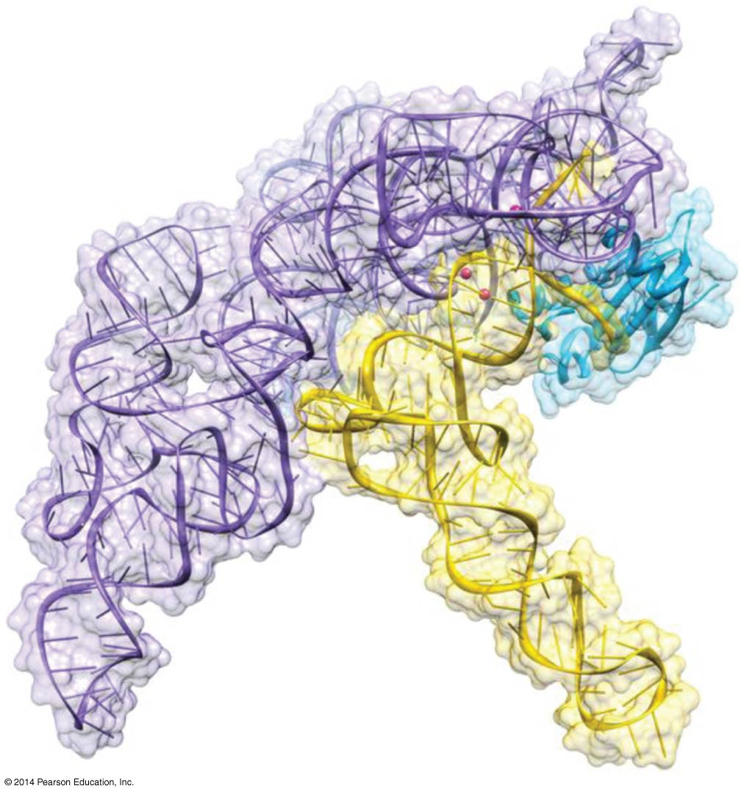
RNase P cleaves a segment of RNA from the 5` end of a precursor to tRNA molecules

Slide 64
Hammerhead ribozyme
A sequence-specific ribonuclease found in infectious RNA agent of plants known as viroids which depends on self-cleavage to propagate.
When replicates, it produces multiple copies of itself in one continuous RNA chain
Single viroids arise by cleavage which is carried out by the RNA sequence around the junction
One such self-cleavage sequence is called the hammerhead because of the shape of its 2º structure which consists of 3 base-paired stems (I, II, III) surrounding a core of noncomplementary nucleotides required for catalysis.

Slide 65
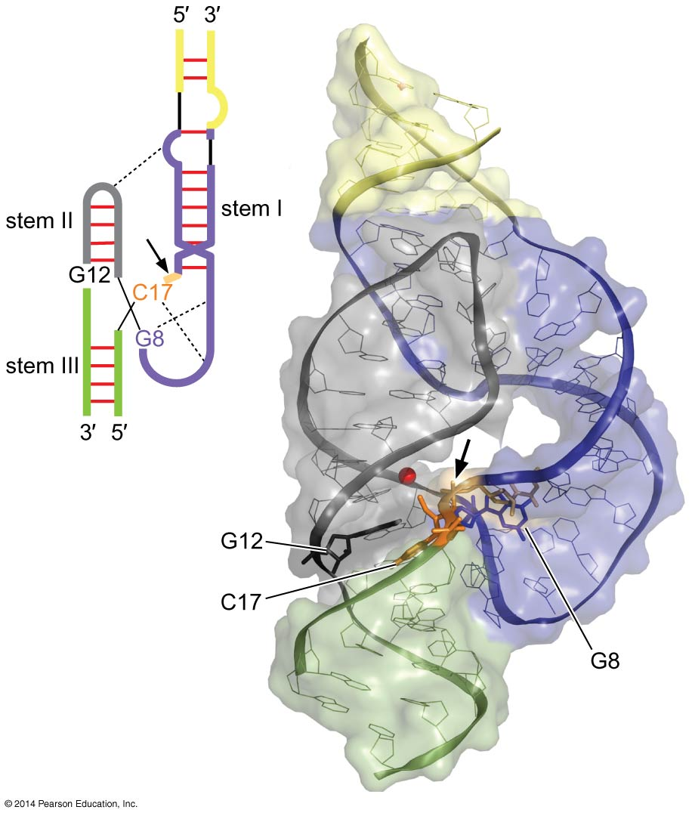
Hammerhead ribozyme structure

Slide 66
How RNA undergoes hydrolysis under alkaline conditions?
At high pH, the 2’-hydroxyl can become deprotonated and the resulting negatively charged oxygen can attack the scissile phosphate at the 3’-position of the same ribose
This breaks the RAN chain, producing a 2’,3’ cyclic phosphate and a free 5’-hydroxyl
Each ribose can undergoes this reaction completely cleaving the parent molecule into nucleotides
Many protein ribonucleases also cleave their RNA substrate via the formation of a 2’,3’ cyclic phosphate
Working at normal cellular pH, these protein enzymes use a metal ion, bound to their active site, to activate the 2’-hydroxyl of the RNA
Notes:
scissile

Slide 67
The hammerhead also cleaves the RNA via the formation of a 2’,3’ cyclic phosphate but the mechanism of the cleavage is not yet understood
Because the normal rxn of the hammerhead is self-cleavage, it is not really a catalyst, each molecule normally promotes a rxn one time only, thus having a turnover number of 1
But the hammerhead can be engineered to function as a true ribozyme by dividing the molecule into two portions-one, the ribozyme that contains the catalytic core and the other, the substrate that contains the cleavage site
The substrate binds to the ribozyme at stems I and III. After cleavage, the substrate is released and replaced by a fresh uncut substrate thereby allowing repeated rounds of cleavage

Slide 68
END

